Slide 1
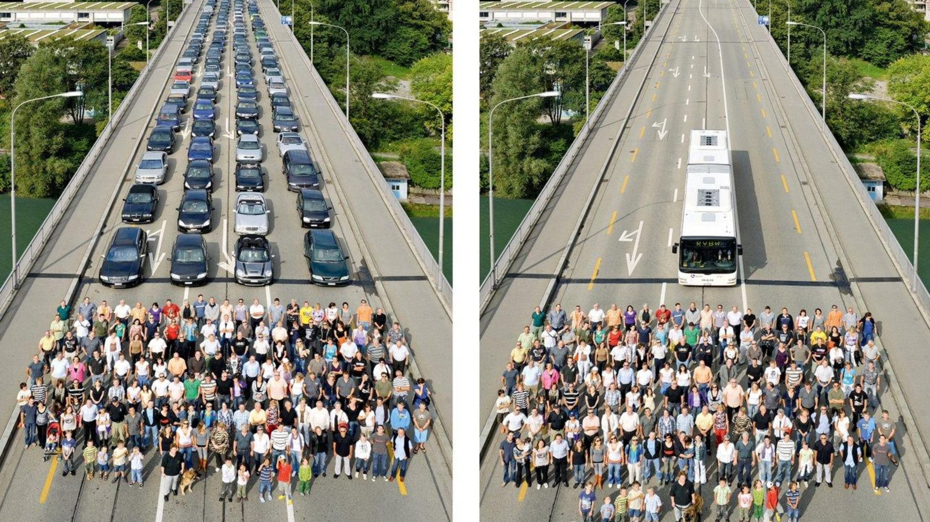
Binary Logit Framework for Mode Choice Analysis
CE 555 – Traffic Engineering I
Term Project Presentation
İkra DURMUŞ DEMİREL - 1908607

Slide 2

METHODOLOGY
Model Building Approach
Descriptive Statistics & Data Preprocessing
Feature Engineering
Transformation of raw stated choice data (403 respondents) into a trip-alternative (long) format, creating two observations per respondent to align with discrete choice modeling requirements.
Creation of derived variables including Driveability (license + car ownership), Affordability (cost-to-income ratio), and Perceived Time (weighted in-vehicle and out-of-vehicle time).
Iterative Estimation
Final Selection
Progressive evaluation starting from single-attribute models (Model Set 1) to multi-attribute specifications (Model Set 2) to identify the most robust predictors.
Selection of the final specification based on statistical performance (Nagelkerke R²), behavioral consistency, and policy relevance.

Slide 3
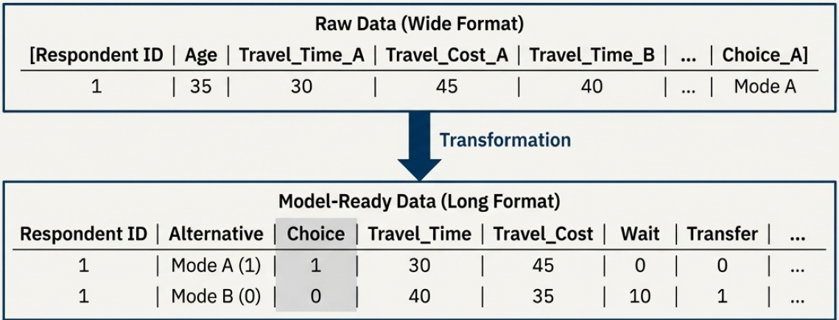
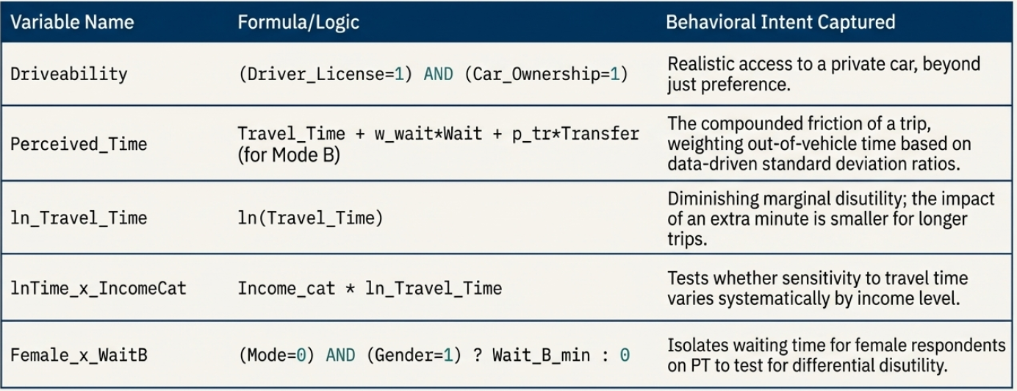
Data Preprocessing
Feature Engineering
Alternative-specific variables
Travel_Time
Travel_Cost
Parking (Mode A only)
Wait (Mode B only)
Transfer (Mode B only)
Comfort (Mode B only)
Perceived_Time (derived, still alternative-specific)
ln_Perceived_Time (derived)
Affordability (e.g. Travel_Cost / Income; alternative-specific)
Derived variables
Alternative-specific derived
Time_Diff_A_B
Perceived_Time
ln_Perceived_Time
Affordability
lnTime_x_Work
lnTime_x_IncomeCat
Individual-specific derived
Income_cat
Work_cat
Driveability
Individual-specific variables
Age
Gender
Education
Income_TRY or/and Income_cat
Working_Status or/and Work_cat
Car_Ownership
Driver_License
Residence_Center
Driveability (derived from car ownership & license)
The variables relating only one modechoice is retianed in the dataset to check the integrity of the dataset
Missingness analysis has been conducted no missing value exist in the data.
Edu_cat={Primary:1, Elementary:2, HighSchool:3, University:4}
Work_cat={Retired:0, Student:1, PartTime:2, FullTime:3}
Incomecat= high:mean+std; medium:mean: low:mean-std

Slide 4
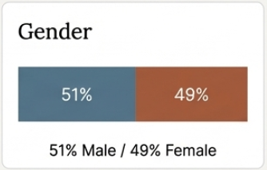
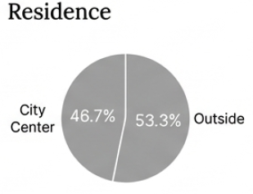
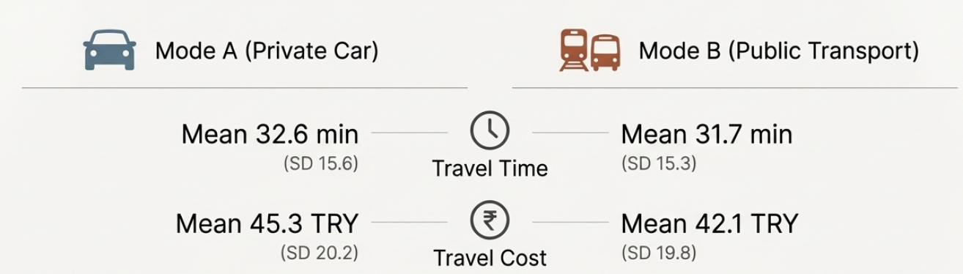
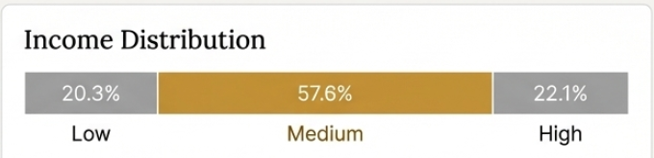
DATA OVERVIEW
Socio-Demographic & Travel Attributes
Sample Characteristics
Travel Attribute Comparison
Variable
Mean / Value
Attribute
Mode A
Mode B
Age
44.3 years
Time (min)
32.64
31.70
Income
50,333 TRY
Cost (TRY)
45.32
42.07
Driveability
27.0% (Yes)
Transfers
—
1.00
Gender
48.9% Female
The sample exhibits significant heterogeneity in income and age, though effective car availability (Driveability) is notably low at 27%.

Slide 5

KEY FINDINGS
Statistical Significance of Choice Drivers
An independent t-test reveals that travel time is the dominant determinant of choice behavior, followed by cost and perceived friction.
Variable | Mean (Choice = 0) | Mean (Choice = 1) | Mean Difference | t | p-value
Travel Time (min) | 39.51 | 24.83 | 14.69 | 15.34 | <0.001
Travel Cost (TRY) | 50.14 | 37.25 | 12.89 | 9.62 | <0.001
Wait (min) | 4.47 | 5.17 | −0.70 | −1.57 | 0.116
Transfers (count) | 0.45 | 0.00 | −0.15 | −2.66 | 0.008
Perceived Time | 59.57 | 49.44 | 10.13 | 4.68 | <0.001
ln(Perceived Time) | 3.95 | 3.63 | 0.32 | 6.45 | <0.001
Affordability | 0.00134 | 0.00100 | 0.00034 | 4.93 | <0.001
Female × Wait | 2.27 | 2.76 | −0.50 | −1.37 | 0.171
Note: Travel time exhibits the largest mean difference (14.69 min) between chosen and non-chosen alternatives (p < 0.001).

Slide 6
MODEL SET 1
Single-Variable Model Performance
Variable | Expected Sign | Coefficient (B) | Std. Error | p-value | Exp(B) | −2LL | Pseudo R² | Utility Function (U_{iA})
Travel_Time | − | −0.073 | 0.006 | <0.001 | 0.930 | 919.67 | 0.290 | =2.348−0.073⋅TT_{iA}
Travel_Cost | − | -0.034 | 0.004 | <0.001 | 0.966 | 1031.378 | 0.135 | =1.496−0.034⋅TCiA ​
Parking | + | -0.291 | 0.167 | 0.081 | 0.747 | 1114.300 | 0.005 | =0.068−0.291⋅Parking_{iA}
Wait | + | 0.017 | 0.011 | 0.117 | 1.018 | 1114.880 | 0.004 | =−0.084+0.017⋅Wait_{iA} ​
Transfer | + | 0.240 | 0.091 | 0.008 | 1.271 | 1110.297 | 0.012 | −0.125+0.240⋅Transfer_{iA}

Slide 7
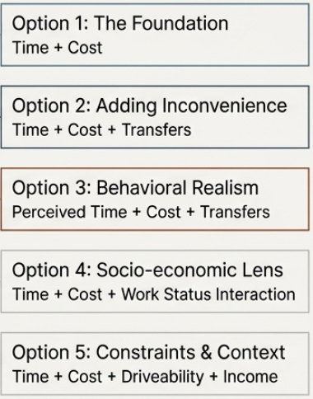
MODEL SET 2
Multi-Attribute Specification Testing
Variable | Expected Sign | Coefficient (B) | Std. Error | p-value | Exp(B) | −2 Log Likelihood | Pseudo R² (Nagelkerke)
Travel Time | − | −0.086 | 0.007 | <0.001 | 0.918
Travel Cost | − | −0.047 | 0.005 | <0.001 | 0.954
Constant | — | 4.829 | 0.369 | <0.001 | 125.14
Model fit |  |  |  |  |  | 805.87 | 0.427
Variable | Expected Sign | Coefficient (B) | Std. Error | p-value | Exp(B) | −2 Log Likelihood | Pseudo R² (Nagelkerke)
Travel Time | − | −0.087 | 0.007 | <0.001 | 0.917
Travel Cost | − | −0.047 | 0.005 | <0.001 | 0.954
Transfers | + | 0.281 | 0.111 | 0.011 | 1.324
Constant | — | 4.706 | 0.372 | <0.001 | 110.64
Model fit |  |  |  |  |  | 799.40 | 0.435
Variable | Expected Sign | Coefficient (B) | Std. Error | p-value | Exp(B) | −2 Log Likelihood | Pseudo R² (Nagelkerke)
ln(Perceived Time) | − | −1.772 | 0.183 | <0.001 | 0.170
Travel Cost | − | −0.042 | 0.004 | <0.001 | 0.959
Transfers | + | 1.203 | 0.141 | <0.001 | 3.331
Constant | — | 7.956 | 0.736 | <0.001 | 2853.65
Model fit |  |  |  |  |  | 895.71 | 0.321
Variable | Expected Sign | Coefficient (B) | Std. Error | p-value | Exp(B) | −2 Log Likelihood | Pseudo R² (Nagelkerke)
ln(Travel Time) | − | −2.245 | 0.194 | <0.001 | 0.106
ln(Time) × Work | − | −0.014 | 0.022 | 0.534 | 0.986
Travel Cost | − | −0.045 | 0.005 | <0.001 | 0.956
Constant | — | 9.601 | 0.755 | <0.001 | 14782.77
Model fit |  |  |  |  |  | 812.70 | 0.420
Variable | Expected Sign | Coefficient (B) | Std. Error | p-value | Exp(B) | −2 Log Likelihood | Pseudo R² (Nagelkerke)
Travel Time | − | −0.086 | 0.007 | <0.001 | 0.917
Travel Cost | − | −0.047 | 0.005 | <0.001 | 0.954
Driveability | + | −0.142 | 0.197 | 0.471 | 0.867
Income_cat | − | −0.001 | 0.133 | 0.994 | 0.999
Constant | − | 4.879 | 0.462 | <0.001 | 131.56
Model fit |  |  |  |  |  | 805.35 | 0.428

Slide 8


RESULTS
The Final Model Specification
The final model prioritizes simplicity and statistical strength, focusing on core travel attributes that drive 43.5% of the observed variation.
Variable
Coefficient (B)
Std. Error
p-value
Exp(B)
Travel Time
-0.087
0.007
<0.001
0.917
Travel Cost
-0.047
0.005
<0.001
0.954
Transfers
0.281
0.111
0.011
1.324
Constant
4.706
0.372
<0.001
110.64
Model Fit: -2 Log Likelihood = 799.40 | Nagelkerke R² = 0.435

Slide 9
PREDICTIONS
Hypothetical Choice Probabilities
Applying the final utility function to hypothetical scenarios demonstrates intuitive behavioral responses.
Low Friction Scenario
1
Time: 20m | Cost: 18 TRY | Transfers: 0
P(Mode A) = 0.89
High Friction Scenario
2
Time: 70m | Cost: 50 TRY | Transfers: 2
P(Mode A) = 0.04
Indifference Point
3
Time: 45m | Cost: 26 TRY | Transfers: 2
P(Mode A) = 0.53

Slide 10
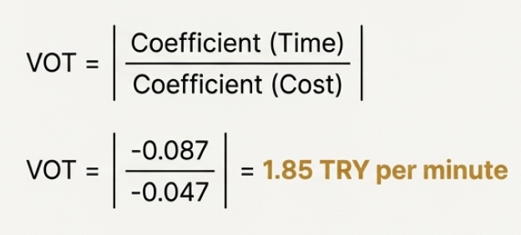
ECONOMIC INTERPRETATION
Value of Time (VOT) Analysis
111 TRY / Hour
The implied Value of Time is calculated as the ratio of the travel time coefficient to the travel cost coefficient (βTT / βTC).
Policy Significance
High sensitivity to time savings relative to monetary cost.
Interventions reducing generalized travel time generate substantial perceived benefits.

Slide 11
IMPLICATIONS
Behavioral Interpretations & Policy
Time Efficiency Priority
Targeted Pricing
Intermodal Integration
Policies should target network optimization and dedicated lanes (e.g., BRT/Metrobus) to address the dominant disutility of travel time.
Pricing instruments like fare adjustments, adjusted parking fees, low-emission zone charges are effective but should be combined with time-saving improvements for maximum impact.
Reducing the number of transfers through coordinated schedules and MaaS tools can meaningfully lower the perceived inconvenience of public transport.
Conclusion: Mode choice in this dataset is driven primarily by experienced travel conditions rather than individual socio-economic characteristics.

